Slide 1


SIMATS ENGINEERING Saveetha Institute of Medical and Technical Sciences Chennai-602105.
STUDENT COURSE REGISTRATION
Presentation By: B.V Sravana Kumar Joshi - 192311270
Supervisor: Dr. L. Reetha

Slide 2

AIM:
To develop a Student Course Registration System that allows students to register for courses online, while enabling administrators to manage course offerings and student enrollments efficiently and securely.
ABSTRACT:
Simplifies Course Enrollment: Provides a user-friendly web platform for students to browse and register for available courses online.
Admin Course Management: Allows administrators to manage course data, approve or reject student registrations, and maintain up-to-date course offerings.
Secure and Efficient System: Developed using HTML, CSS, PHP, and MySQL to ensure real-time updates, secure authentication, and efficient handling of student and course data.

Slide 3
INTRODUCTION:
Course registration is a critical academic process in every educational institution, determining students’ academic journey for a term or semester.
Traditional methods of course registration often involve paperwork, manual processing, and are prone to delays and errors.
A Student Course Registration System automates the process, allowing students to register for courses online while enabling administrators to manage course offerings efficiently.
The system enhances accessibility, reduces administrative overhead, and ensures accurate and secure data handling.
ALGORITHM:
User Registration/Login: The student opens the website and either registers as a new user or logs in using valid credentials.
Credential Verification: The system verifies the user's login credentials with the data stored in the database.
Course Display: Upon successful login, the student is presented with a list of available courses.
Course Selection: The student selects the desired courses and submits the registration form.
Duplicate/Limit Check: The system checks for duplicate registrations and ensures that students do not exceed the maximum allowed courses.
Data Storage: The selected courses are saved in the database under the student's profile.
Confirmation and Dashboard Update: The system confirms registration and updates the student dashboard with registered courses. Admins can view and manage all enrollments.

Slide 4
FLOW DIAGRAM
START
User Login Page
Already Registered?
Check Credentials
YES
Register for Courses
NO
Save Registration
Update and confirm Dashboard
END

Slide 5
PSEUDOCODE
Index.php <div class="login-container">
<h2>Login</h2>
<?php if ($error) echo "<div class='error'>$error</div>"; ?> <form method="post" action="">
<label for="username">Username:</label>
<input type="text" id="username" name="username" required /> <label for="password">Password:</label>
<input type="password" id="password" name="password" required /> <label for="role">Role:</label>
<select id="role" name="role" required>
<option value="">Select role</option>
<option value="admin">Admin</option>
<option value="student">Student</option>
</select> <button type="submit" name="login">Login</button>
</form>
<div class="register-link">
Don't have an account? <a href="register.php">Register here</a>
</div>
</div>
Logout.php <?php
session_start();
session_destroy();
header("Location: index.php");
exit();
Register_course.php $insertStmt = $conn->prepare("INSERT INTO registrations (student_username, course_id) VALUES (?, ?)");
$insertStmt->bind_param("si", $username, $course_id);
if ($insertStmt->execute()) {
$_SESSION['success'] = "Successfully registered for the course.";
} else {
$_SESSION['error'] = "Registration failed. Please try again.";
}
$insertStmt->close();
header("Location: dashboard.php");
exit();
} else {
header("Location: dashboard.php");
exit();
}

Slide 6
PSEUDOCODE
Edit_course.php if (isset($_GET['edit_id'])) {
$edit_id = intval($_GET['edit_id']);
$stmt = $conn->prepare("SELECT id, code, name, seats FROM courses WHERE id = ?");
$stmt->bind_param("i", $edit_id);
$stmt->execute();
$result = $stmt->get_result();
$edit_course = $result->fetch_assoc();
$stmt->close();
} Dashboard.php <?php
if (isset($_SESSION['error'])) {
echo '<div style="color: #d9534f; font-weight: bold; margin-bottom: 15px;">' . htmlspecialchars($_SESSION['error']) . '</div>';
unset($_SESSION['error']);
}
if (isset($_SESSION['success'])) {
echo '<div style="color: #28a745; font-weight: bold; margin-bottom: 15px;">' . htmlspecialchars($_SESSION['success']) . '</div>';
unset($_SESSION['success']);
}
?>
db.php <?php
$servername = "localhost"; // Your database server (likely localhost)
$username = "root"; // Your database username
$password = ""; // Your database password
$dbname = "course"; // Your database name
// Create connection
$conn = new mysqli($servername, $username, $password, $dbname);
// Check connection
if ($conn->connect_error) {
die("Connection failed: " . $conn->connect_error);
}
?>

Slide 7
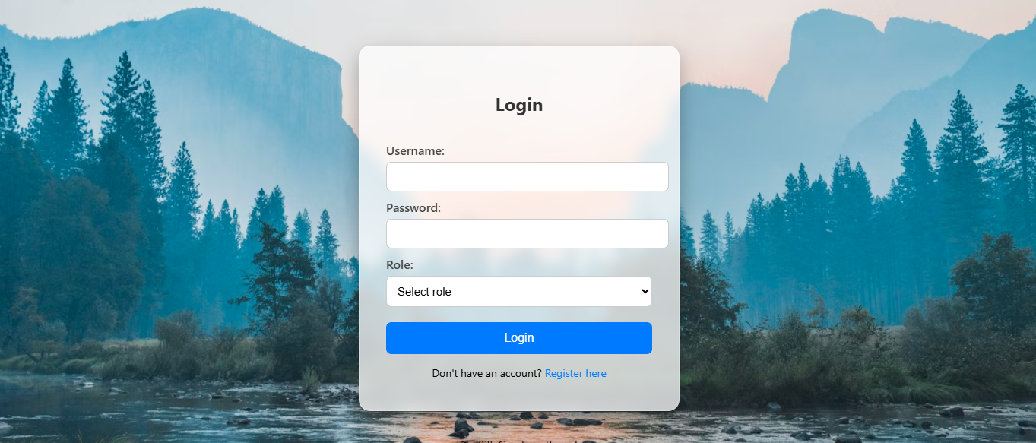
INPUT/OUTPUT
Fig1: Login Page

Slide 8
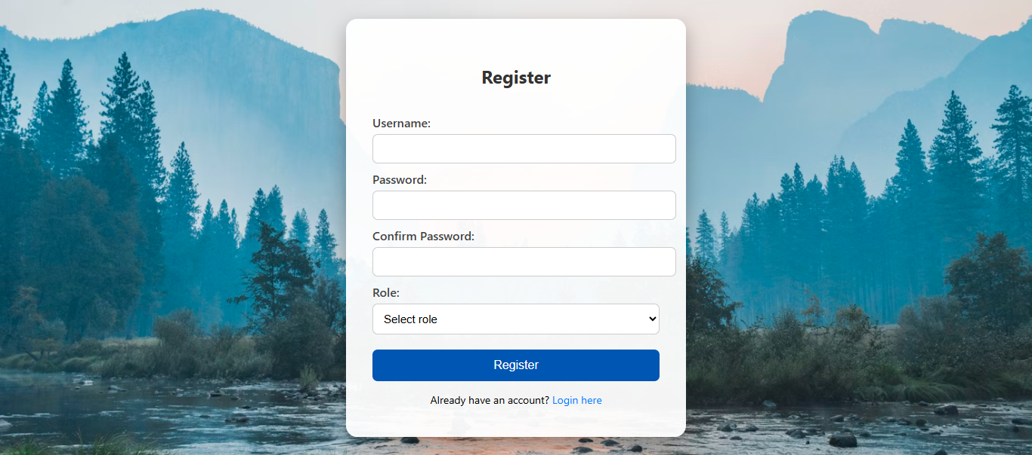
INPUT/OUTPUT
Fig2: Registration Page

Slide 9
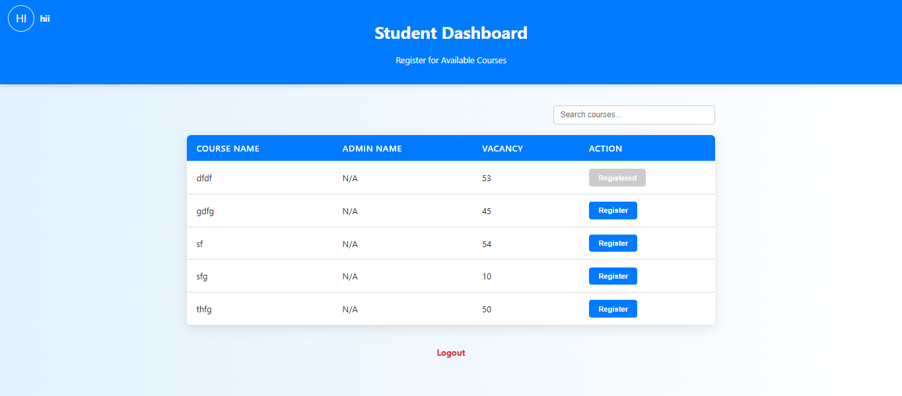
INPUT/OUTPUT
Fig3: Dashboard Page

Slide 10
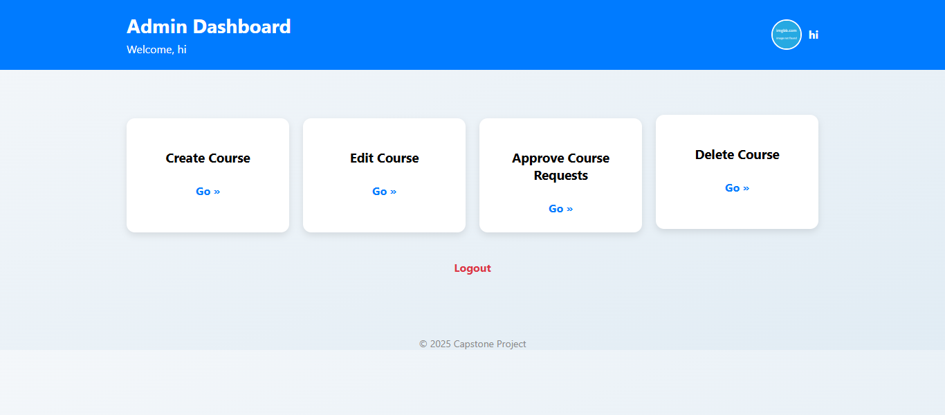
INPUT/OUTPUT
Fig3: Admin(faculty) Page

Slide 11
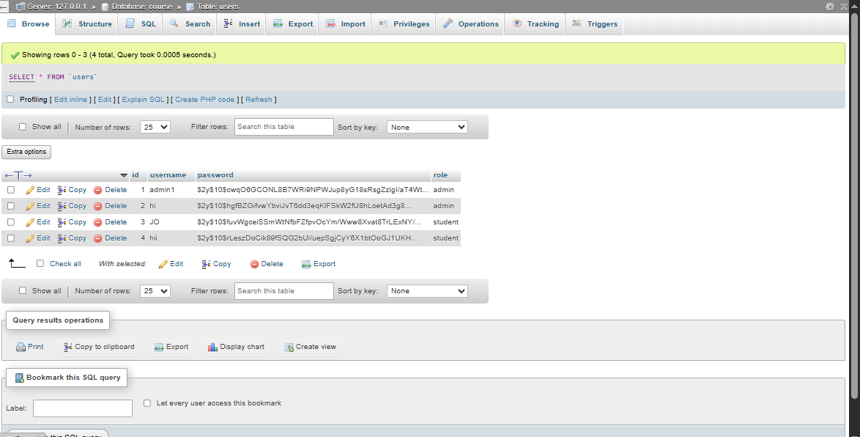
INPUT/OUTPUT
Fig4: Backend Data

Slide 12
REFERENCES
Welling, Luke, and Thomson, Laura. PHP and MySQL Web Development. Addison-Wesley, 2016.
Duckett, Jon. HTML and CSS: Design and Build Websites. Wiley, 2011.
Ullman, Larry. PHP for the Web: Visual QuickStart Guide. Peachpit Press, 2018.
PHP Official Documentation – https://www.php.net/docs.php
MySQL Official Documentation – https://dev.mysql.com/doc/
W3Schools – https://www.w3schools.com

Slide 13
RESULT ANALYSIS
Secure login with role-based access for students.
Dashboard displays all available courses with seat availability.
Students can search courses and send registration requests.
Registration buttons disable for full courses or already registered courses.
Real-time seat vacancy calculation ensures accuracy.
Clean, responsive UI for easy navigation and course selection and user-friendly.
Confirmation message displayed after successful course request submission.
Profile photo and student name are shown on the dashboard for personalization.

Slide 14


